Slide 1
Hologic’s Database Design
Group 5 (Healthcare)
Team Members: Pedro Ropain, Meng(Michelle) Wang, Yubing (Ellie), and Yousun (Jennie) Kang

Slide 2
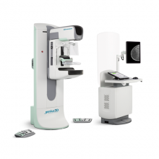
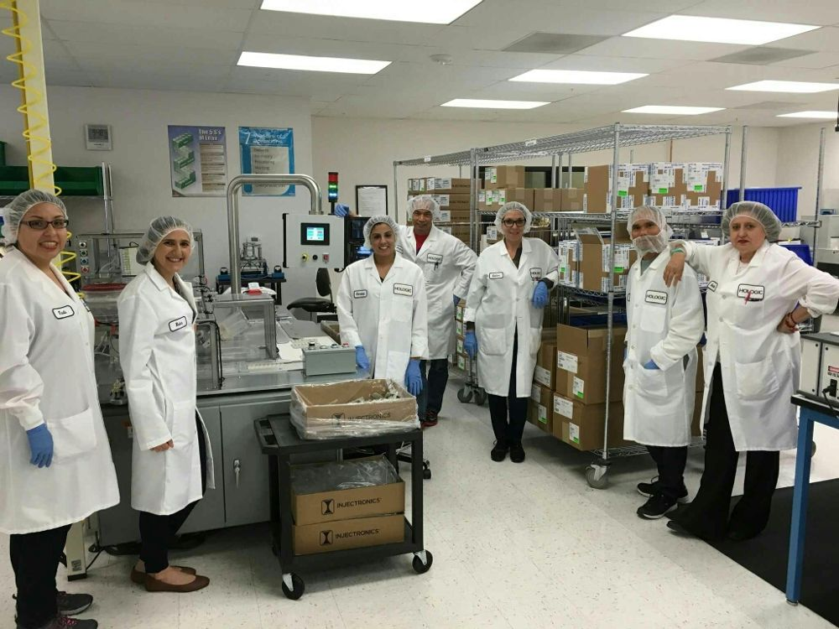

Hologic’ Core Business Functions
Sales
Diagnostic imaging products and medical equipment
R & D
Developing new technologies based on the necessity in the market
Maintenance
Maintenance services for products

Slide 3
Proposal
Goals of the project
Strengthen innovation capability
Improve the efficiency of their sales operation
R&D
Function we want to achieve
Connect R&D with partners
Connect Sales representatives, sales support and clients
Sales People
Main Users
Technical Support

Slide 4
Core Business Rules Clarification
* Full version available at https://docs.google.com/document/d/19bMVVMDMuqedQQ8efQxzXtBDsp6Euel2CDE_XnP5Cwg/edit?usp=sharing
Products & Clinic trials: ‘On Market’ = Passed Clinic Trials+Other Pre-market Procedures;
Customers: medical centers within the U.S.
Orders & Shipment & Sales: multiple orders could be shipped together if necessary;
salespersons function at order level.
discounts are applied at order level, not at product level.
Maintenance: maintenance requests should be made separately for multiple products.

Slide 5
Products & Clinic Trials
Some products require clinical trial procedures and some don’t:
-Products that don’t need clinical trials:
Diagnostic Category->Panther Fusion Open Access
GYN Category->Aquilex Fluid Management System
-Most of the product requires clinical trials.
Each product has at most one clinical trial. But under one clinical trial, there may be multiple lines tested in different places with different business partners.
Product can be sold in the market only if all trial lines of a product succeeds and completes all the necessary procedures.

Slide 6
Sales & Orders & Shipment & Payment:
One becomes a customer when a customer places at least one order.
A salesperson can only manage one territory. But in a territory, there may be multiple salespersons.
Hologic customers are classified by their specialty: Medical, Aesthetics, Diagnostic, Surgical, etc..
Customer places an order directly after fully communicated with salesperson. Customer can place multiple orders.
For shipment, the company will combine several products into one package depends of product availability. There may be multiple order lines in one shipment ID.
For each order, there is one payment ID.
Discount of 10% is applied to customers who pay within 90 days after order date
Discount applies to total order amount, and not as an individual product level.

Slide 7
Requests & Maintenance
Customer can make 0 to several maintenance requests.
Maintenance request has one product ID. If a customer has more than one product to be repaired at the same time, separate requests for each product are required.
Each maintenance request has Request ID. Request ID contains productID, customer ID and submit time.
Maintenance request may lead to 1 to several maintenance visits. One technical support will be provided for each maintenance visit.
Some technical support staff may not have made any maintenance visits as they may be new hires.

Slide 8
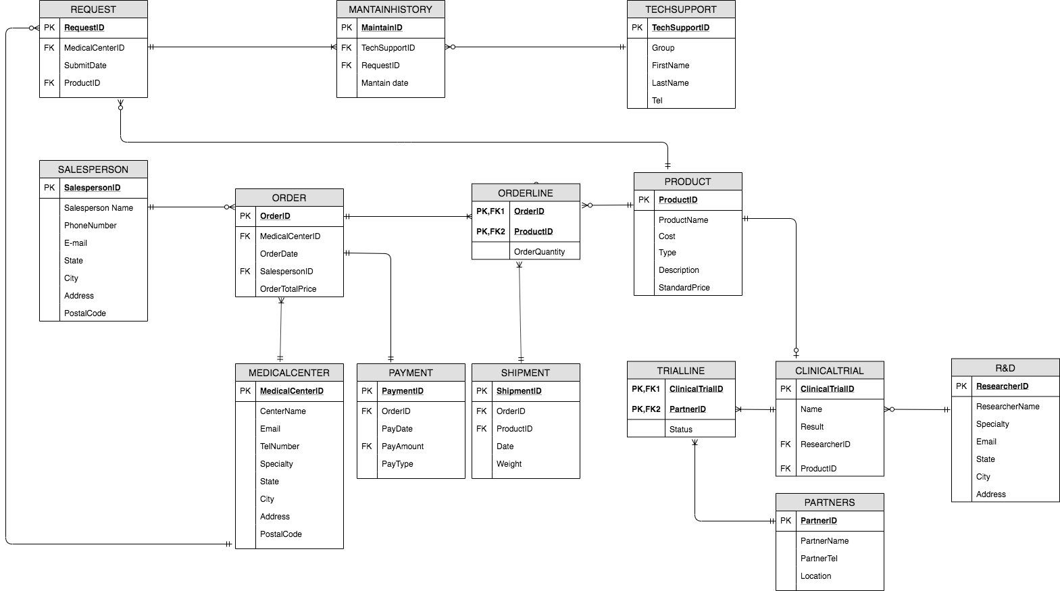
ER Implement

Slide 9
With 14 tables in total,
WE WANT TO ASK:

Slide 10
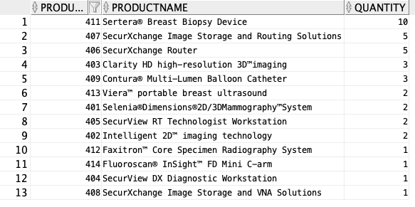
Q1: List from highest to lowest about how many quantities are bought for each product?
Ellie

Slide 11
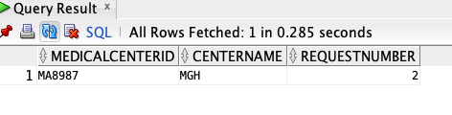
Q2: Which customer submits most maintenance requests?
Ellie

Slide 12
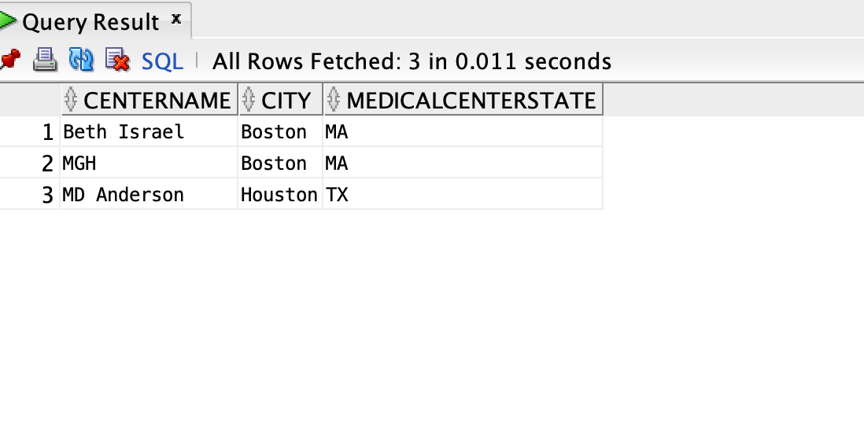
Q3: Select the medical centers, city and state that has set orders above $200,000, Order by city
Pedro
Notes:
select distinct Centername, city, medicalcenterstate
From Hologicmedicalcenter_T
Join Hologicorder_T on Hologicmedicalcenter_T.medicalcenterID = HologicOrder_T.medicalcenterID
Where orderfinalprice > 200000
order by city;

Slide 13
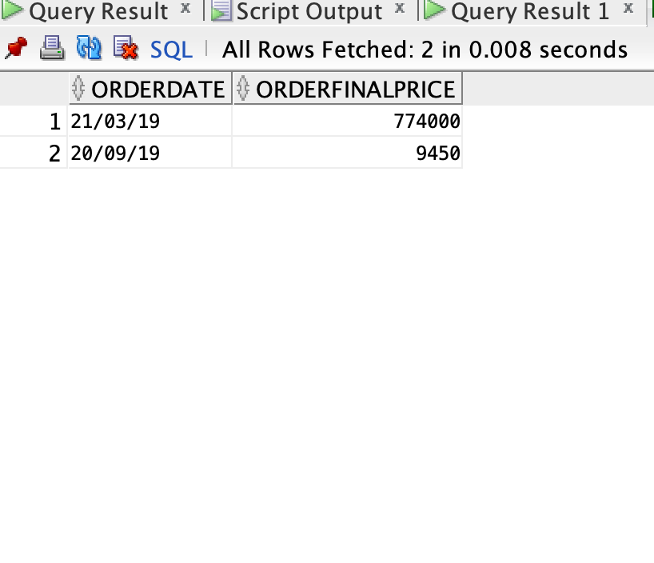
Q4: Which day was has the highest revenue and which the least.
Pedro
Notes:
select orderdate, orderfinalprice
from hologicorder_T
where orderfinalprice =
(select max(orderfinalprice)
from hologicorder_T)
union
select orderdate, orderfinalprice
from hologicorder_T
where orderfinalprice =
(select min(orderfinalprice)
from hologicorder_T);

Slide 14
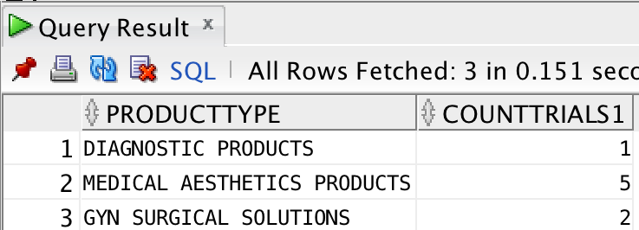
Q5:How many clinical trials are going on for each product type?
Meng

Slide 15
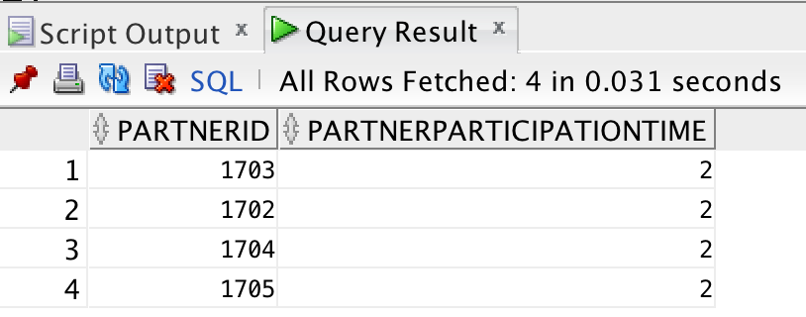
Q6:What are the partners' ID who are participating more than one clinical trial?
Meng

Slide 16
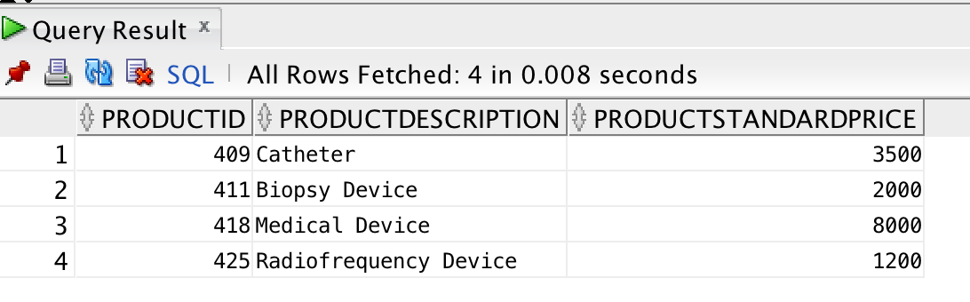
Q7: List all products that have a standard price less than $10,000.
Jenny
Notes:
SELECT ProductID, ProductDescription,ProductStandardPrice
FROM HologicProduct_T
WHERE ProductStandardPrice < 10000;

Slide 17
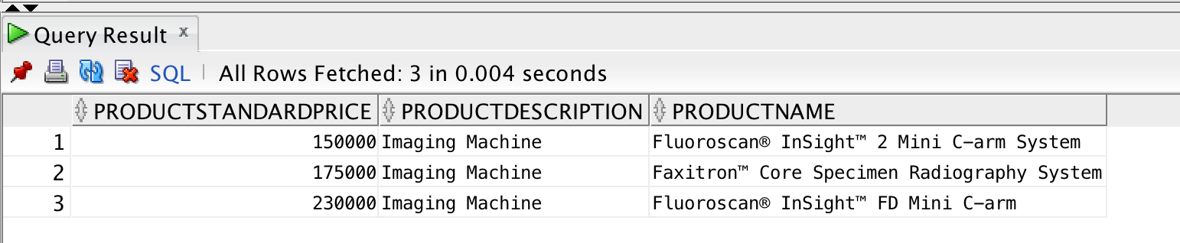
Q8: Which products in Hologic Product table have a standard price greater than or equal to $100,000 and have included product description in ‘imaging machine’?
Jenny
Notes:
SELECT ProductStandardPrice, ProductDescription, ProductName
FROM HOLOGICPRODUCT_T
WHERE ProductStandardPrice >= 100000 AND ProductDescription = 'Imaging Machine'
ORDER BY ProductStandardPrice;

Slide 18
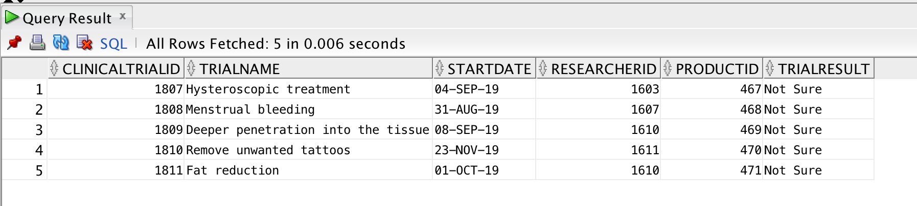
Q9 What are the clinical trials that started at the second half of 2019?
Notes:
select * from Hologicclinicaltrial_t
where startdate>'30-Jun-2019';

Slide 19
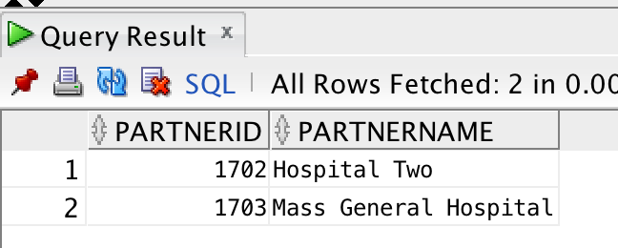
Q10 What are the partners of the company located in Boston?
Notes:
select * from Hologicclinicaltrial_t
where startdate>'30-Jun-2019';

Slide 20
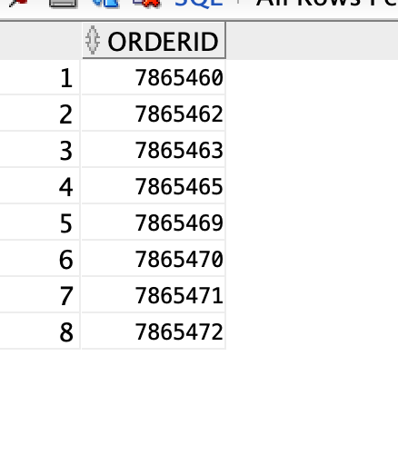
Q11 list the orderID's which paid with check

Slide 21
Q & A ?

